Slide 1

Thomas Stoyles 2312447

Slide 2
Data
Partition of data
Data was partitioned into the training and testing set with a 80/20 split
Processing of data
Data was pre-processed using normalization

Slide 3
Design choices – forward
Input
Hidden
Output
Bias
Bias
Bias
N

Slide 4
Design choices – Backwards
Input
Hidden
Output
Bias
Bias
Bias
N

Slide 5
Design choices
Choose to only allow 1 hidden layer as this is not a deep learning task
If this was a deep learning task, then I would have multiple hidden layers

Slide 6
Size choices
Never changing values | Hidden Node Amount | Training RMSE(4 dps) | Testing RMSE(4 dps)
Lambda = 0.1, Eta = 0.1, epoch = 100 | 5 | 0.7294 | 0.7118
Lambda = 0.1, Eta = 0.1, epoch = 100 | 6 | 0.7117 | 0.7080
Lambda = 0.1, Eta = 0.1, epoch = 100 | 7 | 0.7119 | 0.7089
Lambda = 0.1, Eta = 0.1, epoch = 100 | 8 | 0.7098 | 0.7058
Lambda = 0.1, Eta = 0.1, epoch = 100 | 9 | 0.7119 | 0.7085
Lambda = 0.1, Eta = 0.1, epoch = 100 | 10 | 0.7100 | 0.7064

Slide 7
Size choices
Never changing values | Lambda Amount | ETA Amount | Training RMSE(4 dps) | Testing RMSE(4 dps)
Epochs = 100, Hidden nodes = 10 | 0.1 | 0.1 | 0.7100 | 0.7118
Epochs = 100, Hidden nodes = 10 | 0.01 | 0.01 | 0.7555 | 0.7499
Epochs = 100, Hidden nodes = 10 | 0.05 | 0.05 | 0.7007 | 0.7065

Slide 8
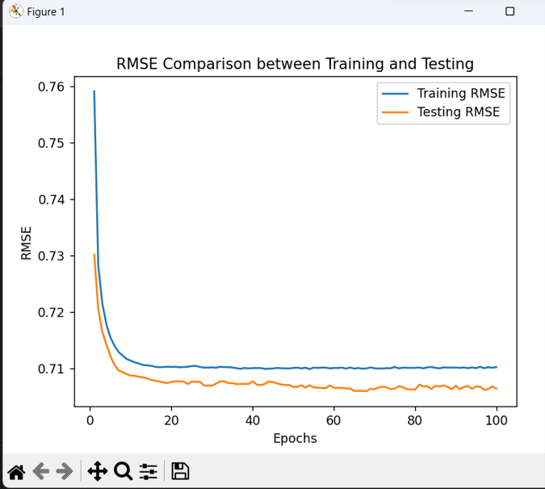
Final Graph with all tested parameters

Slide 9
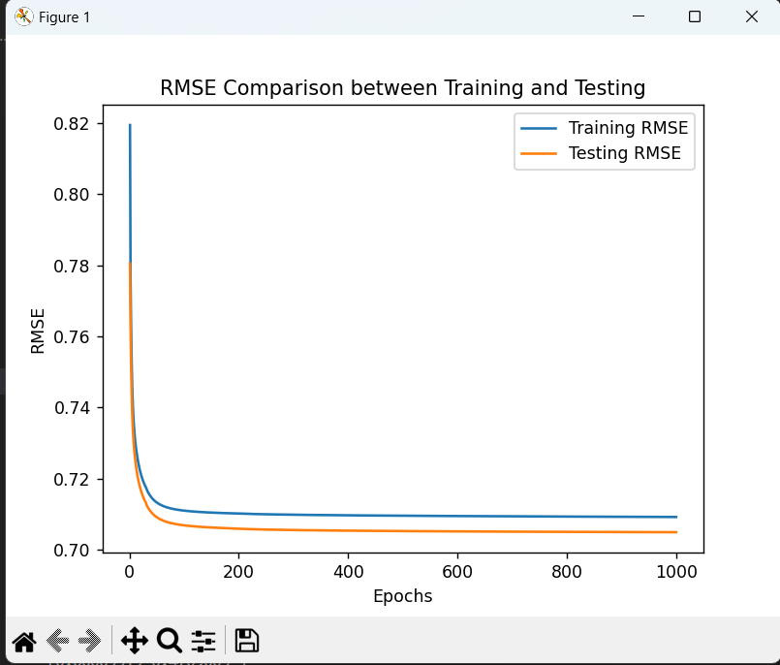
Graph -1000 epochs

Slide 10
Parameters
What did you pick
The values that I have chosen is 0.05 for the learning rates, 500 epochs and 10 hidden nodes.
How did you pick them
These have been picked after testing all different values for each, then taking the value that lowers the RMSE the most.
What effect did they have
The lower RMSE the better the rocket performed.

Slide 11
RMSE and Stopping Criteria
What is the RMSE values
0.7007
What did you pick as your early stopping criteria and why
Stopping early criteria is the amount of epoch used in the code. After 100 epochs it is minimal gains therefore, I stopped at 100.

Slide 12
Above and beyond
What extra did you do
Removing zeros and replacing with the average value of that column
Removed null values and replaced with the average value of that column

